Slide 1

“DEFAULT OF CREDIT CARD CLIENTS DATA SET”
FROM
UCI MACHINE LEARNING REPOSITORY
SUBMITTED BY: SANJU KUMAR GIRI (吉瑞)

Slide 2

ABSTRACT
This project aims to analyze the "Default of Credit Card Clients" dataset using data mining techniques and machine learning algorithms to gain insights into factors influencing credit card default. The dataset includes demographic factors, payment history, bill statements, and financial indicators. The report covers the project introduction, literature review, dataset overview, algorithms used, implementation process, and experiment setup. It includes steps for data preprocessing, and hyperparameter exploration, and presents the results of different algorithms. The conclusion emphasizes the importance of EDA, data preprocessing, and hyperparameters and suggests potential improvements. The project contributes to credit risk management and provides valuable insights for decision-making in the financial industry.

Slide 3
1. INTRODUCTION
2. EXPERIMENT SETUP
3. RESULTS
Contents
4. CONCLUSION & RECOMMENDATION
5. REFERENCES

Slide 4

PART 01
1
INTRODUCTION

Slide 5
INTRODUCTION OF THE PROJECT
Credit card default prediction is crucial for financial institutions and individuals.
Machine learning algorithms can accurately predict credit card default.
The project focuses on developing robust models for credit card default classification.
Data is acquired from the UCI Machine Learning Repository.
Exploratory data analysis provides initial insights into the dataset.
Data preprocessing includes handling duplicates, missing values, outliers and feature scaling.
The dataset is split into training and testing sets for model evaluation.
Six machine learning algorithms are used: Logistic Regression, SVM, ANN, Random Forest, XGBoost, and CNN.
Hyperparameter tuning is performed to optimize model performance.
Models are trained on the training set and evaluated on the testing set.
Evaluation metrics include accuracy, precision, recall, F1-score, and AUC-ROC.
Results are analyzed for each algorithm, including best parameters and scores.
Confusion matrices, classification reports, and ROC curves are presented.
Training and testing accuracy graphs visualize model performance.
The project helps financial institutions make data-driven decisions to mitigate credit card default risk.
Lending strategies and business operations can be optimized based on the insights gained.

Slide 6
LITERATURE REVIEW
"Yeh, I. C., & Lien, C. H. (2009). The comparisons of data mining techniques for the predictive accuracy of probability of default of credit card clients. Expert Systems with Applications, 36(2), 2473-2480.“
The paper compares the predictive accuracy of six data mining techniques for estimating the probability of default of credit card clients. The data mining techniques are:
• Logistic regression
• Decision trees
• Support vector machines
• Artificial neural networks
• k-nearest neighbours
• Naive Bayes

Slide 7
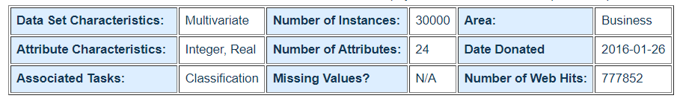
INTRODUCTION TO THE DATASET
Here is a brief overview of some of the key features present in the dataset:
1. Limit Balance: The credit card limit provided to the client.
2. Sex: The gender of the client (1 = male, 2 = female).
3. Education: The educational background of the client (1 = graduate school, 2 = university, 3 = high school, 4 = others).
4. Marriage: The marital status of the client (1 = married, 2 = single, 3 = others).
5. Age: The age of the client in years.
6. Payment History (September 2005 - April 2005): The repayment status of the client's credit card bills, ranging from -2 (no consumption) to 9 (payment duly).
7. Bill Amount (September 2005 - April 2005): The amount of the billing statement for each month.
8. Previous Payment Amount (September 2005 - April 2005): The number of previous payments made by the client for each month.
9. Default Payment: The target variable indicates whether the client defaulted on their credit card payment in the following month (1 = default, 0 = not default).
Dataset Link: https://archive.ics.uci.edu/dataset/350/default+of+credit+card+clients
Figure 1: Dataset Information

Slide 8

ALGORITHMS USED IN THIS PROJECT
Logistic Regression: Estimates probability for binary classification.
Support Vector Machine (SVM): Separates data points using a hyperplane.
Artificial Neural Network (ANN): Deep learning model that learns complex patterns.
Random Forest: Ensemble algorithm combining decision trees.
XGBoost: Optimized gradient-boosting algorithm.
Convolutional Neural Network (CNN): Effective for capturing spatial patterns.
All algorithms used for credit card default prediction.
Figure 2: Algorithms

Slide 9
IMPLEMENTATION PROCESS
1. Importing Libraries: Necessary libraries for analysis, modelling, and visualization are imported.
2. Data Acquisition: The dataset is downloaded and read into a pandas DataFrame.
3. Exploratory Data Analysis (EDA): Initial insights through data visualization and exploration.
4. Data Pre-processing: Handling duplicates, missing values, dropping unnecessary columns, outlier detection, and feature scaling.
5. Data Splitting: The dataset is split into training and testing sets.
6. Model Training and Hyperparameter Tuning: Algorithms are trained on the training set with hyperparameter tuning.
7. Record Computation Time: Measure and record the computation time for each model.
8. Model Evaluation: Evaluate models on the testing set using performance metrics and analyze confusion matrices, classification reports, and ROC curves.
9. Comparison and Selection: Compare algorithm performance and select the best model for credit card default prediction.
10. Recommendations and Insights: Use project results and insights to inform decision-making, optimize lending strategies, and enhance risk management.

Slide 10
PART 01
2
EXPERIMENT SETUP

Slide 11
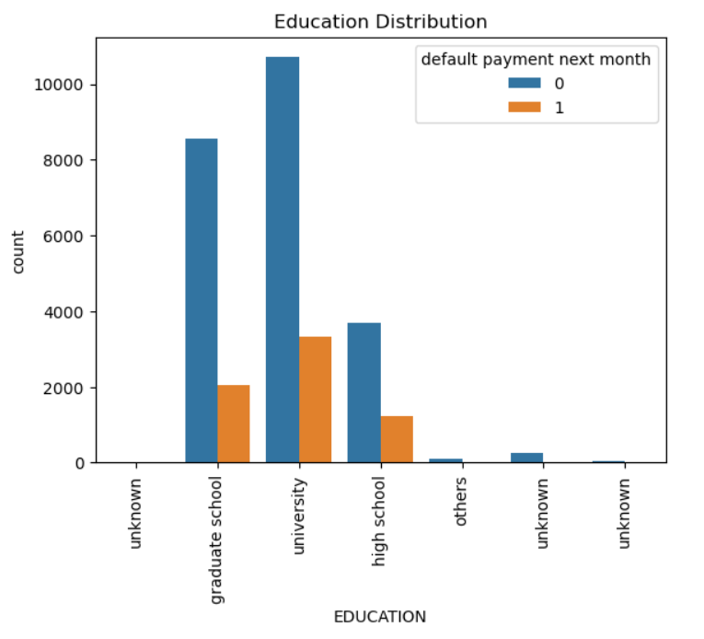
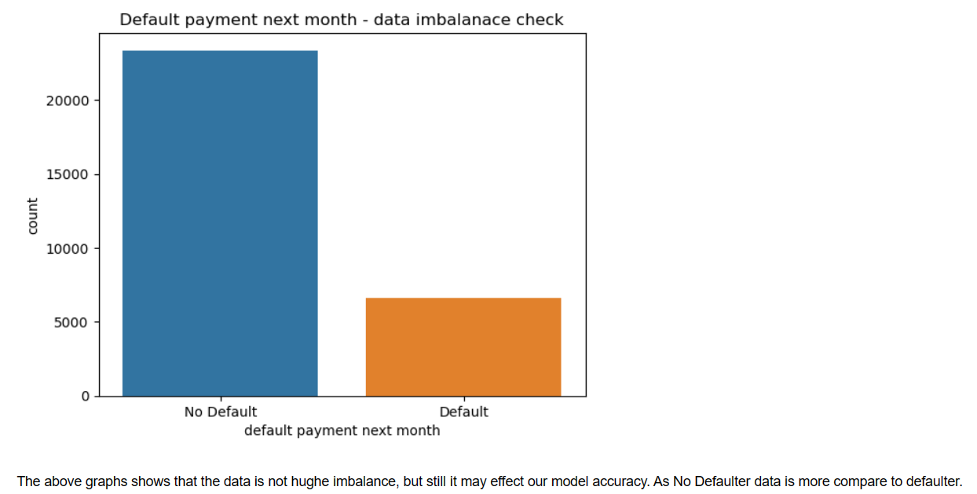
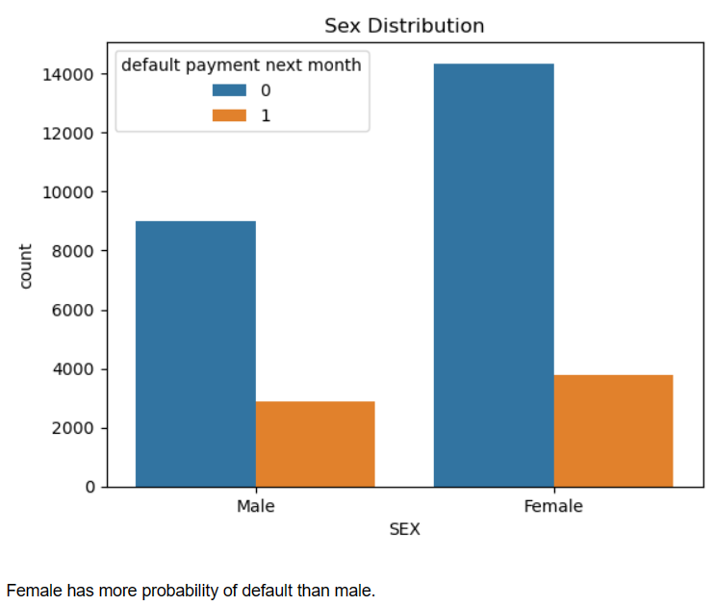
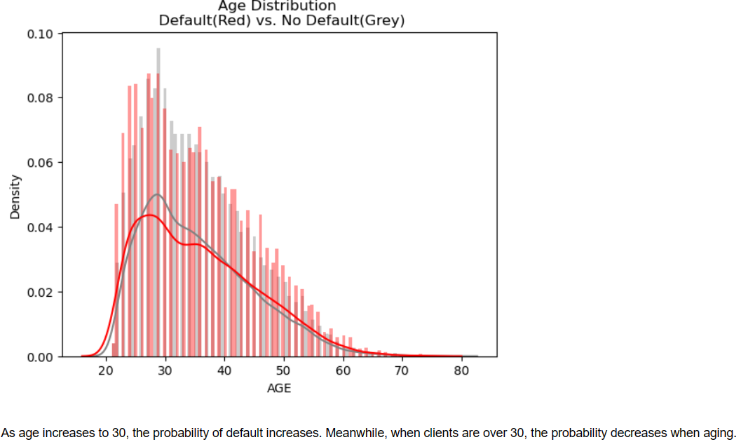
BASIC EDA
Figure 3: Check the imbalance of defaulter and non- defaulter in data
Figure 4: Sex Distribution
Figure 5: Education Distribution
Figure 6: Age Distribution

Slide 12
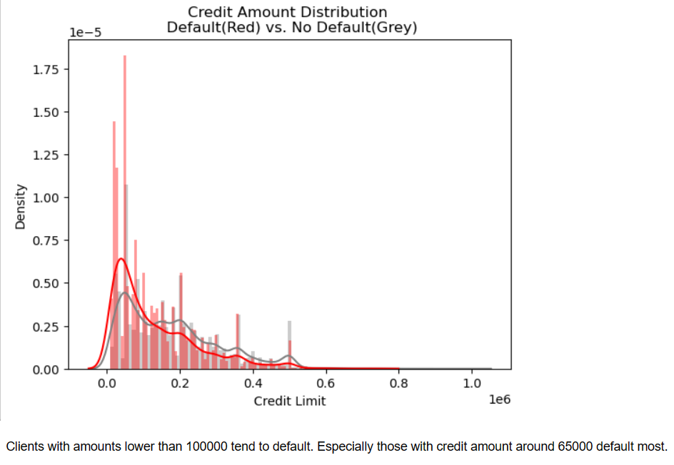
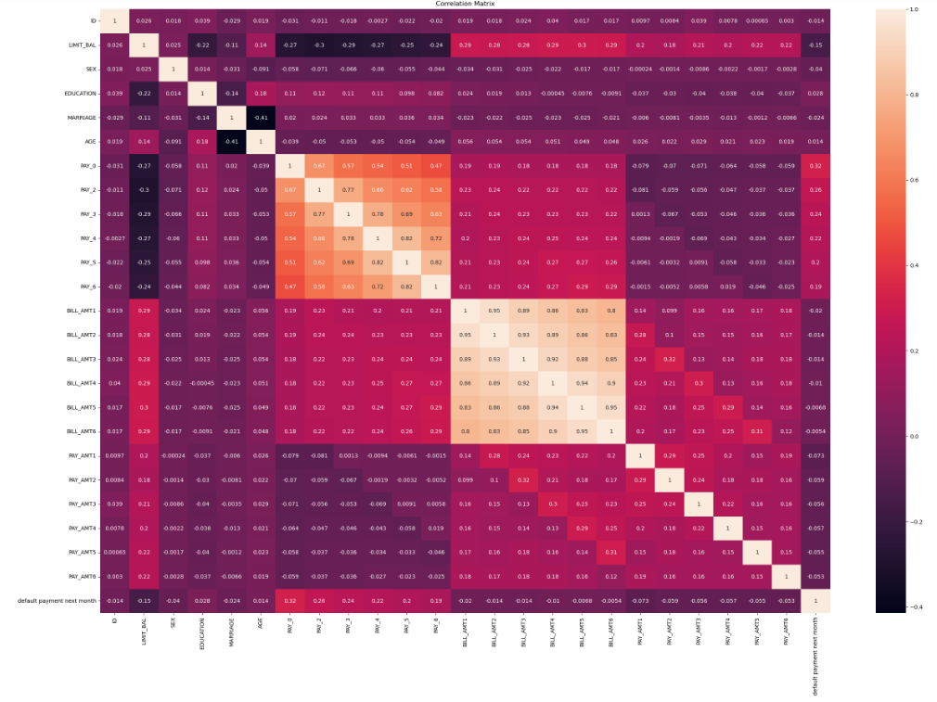
BASIC EDA Continue…
Figure 7: Credit Amount Distribution
Figure 8: Correlation Matrix

Slide 13
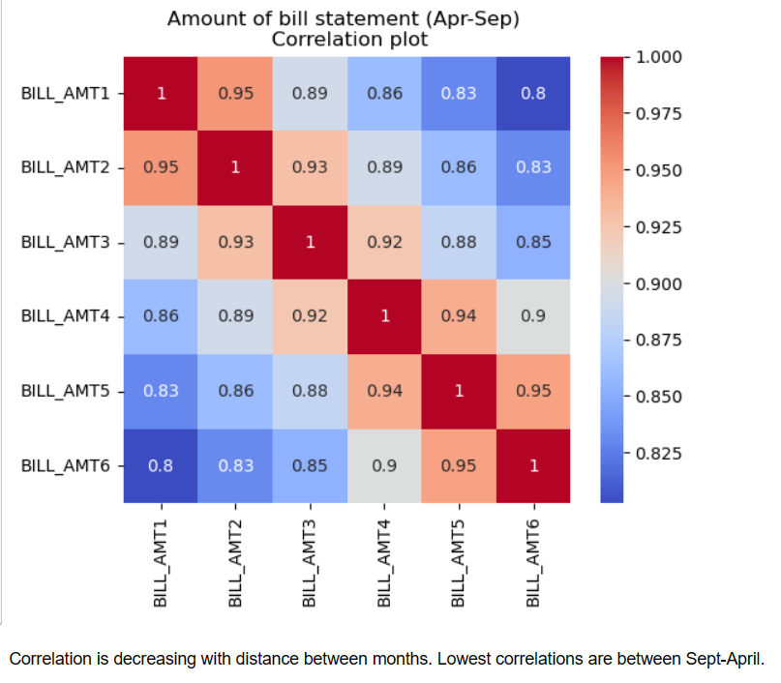
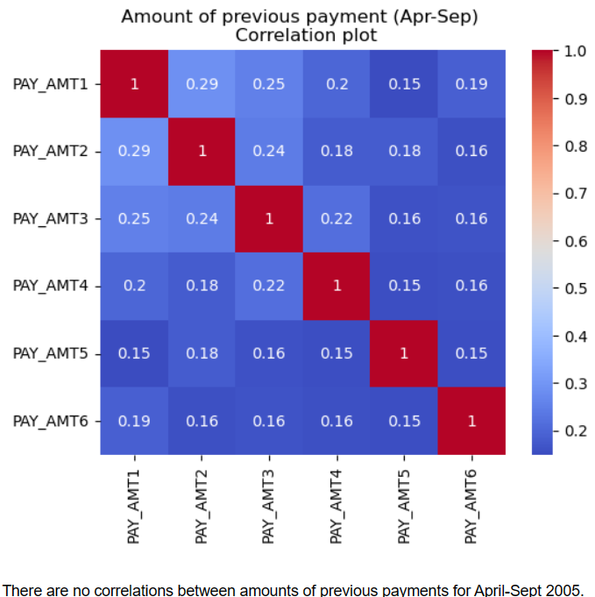
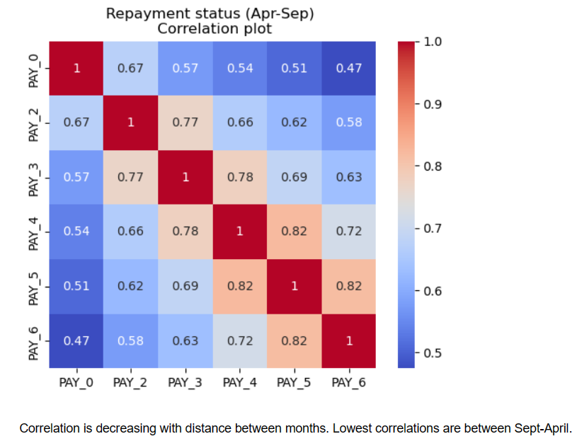
BASIC EDA Continue…
Figure 9: Correlation of the Amount of bill statements in April — September 2005
Figure 11: Correlation between Repayment status in April — September 2005
Figure 10: Correlation of Amount of previous payment in April — September 2005

Slide 14

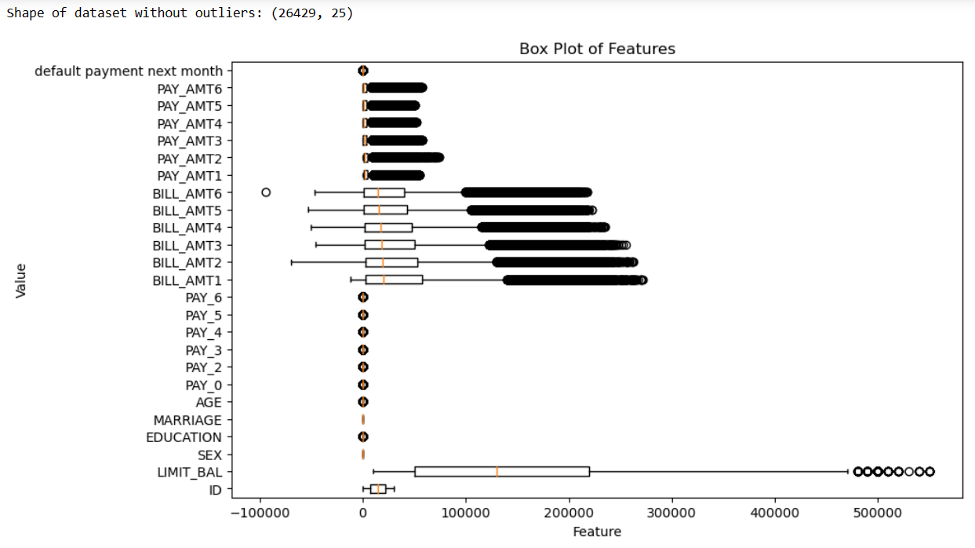
DATA PRE-PROCESSING
- Identified missing values in the dataset.
- Employed strategies based on missingness extent:
- Drop rows with any missing values. (In our case we did this technique)
- Imputation using mean, median, or mode.
- Deletion of rows or columns.
- Advanced techniques like multiple imputations if applicable.
Figure 12: Drop Missing Value if any
- Examined data for outliers.
- Used z-score to measure the distance from mean in standard deviations.
- The defined threshold for outlier detection: z-score > 3 or z-score < -3.
- Identified data points exceeding the threshold as outliers.
Figure 13: Outlier Treatment

Slide 15


DATA PRE-PROCESSING Continue…
- Applied feature scaling techniques.
- Aimed to ensure consistent scale for sensitive algorithms (e.g., SVM, neural networks).
- Used normalization to scale features within the range of 0 to 1.
Figure 14: Feature Scaling
- Removed the irrelevant column 'ID'.
- Purpose: Enhance model performance and eliminate unnecessary information.
- Data Splitting: Split dataset into training and testing sets.
- Purpose: Train models and evaluate their performance.
- Random assignment: Assign a certain percentage (e.g., 80%) to the training set and the remaining (e.g., 20%) to the testing set.
- Training set: Used for building and optimizing models.
- Testing set: Utilized to evaluate models on unseen data.
- Generalization assessment: Measure how well models perform on new instances.
- Insight into predictive capabilities.
Figure 15: Removing irrelevant Columns
Figure 16: Splitting data into training and testing

Slide 16
HYPERPARAMETER EXPLORATION
1. Model Selection:
- Experimented with different machine learning algorithms.
- Considered their strengths and limitations.
- Algorithms included linear regression, random forests, xgboost, support vector machines, artificial neural networks, and convolutional neural networks.
2. Hyperparameter Grid:
- Defined a grid of hyperparameters for each algorithm.
- Included various values or ranges for hyperparameters.
- Hyperparameters such as learning rate, regularization strength, maximum depth, number of estimators, or kernel type.
3. Cross-Validation:
- Used cross-validation techniques like k-fold cross-validation.
- Split training data into k subsets (e.g., k=5).
- Trained models on k-1 subsets and evaluated performance on the remaining subset.
- Repeated the process k times to ensure each subset served as the validation set once.
4. GridSearchCV or RandomSearchCV:
- Employed techniques like GridSearchCV or RandomSearchCV.
- Systematically explored the hyperparameter grid.
- Identified the optimal combination of hyperparameters.
- GridSearchCV exhaustively searched all possible combinations.
- RandomSearchCV randomly sampled from the defined grid.
- Evaluation metric used to determine the best model performance.

Slide 17
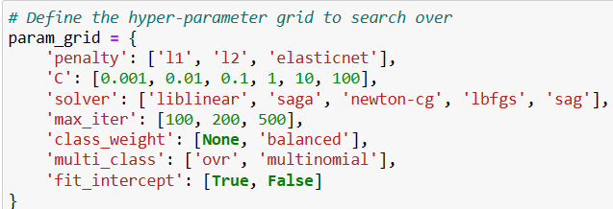
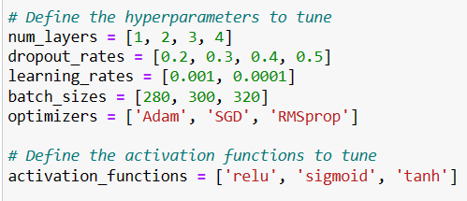
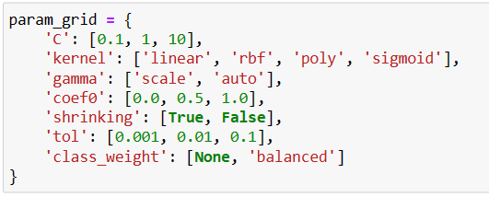
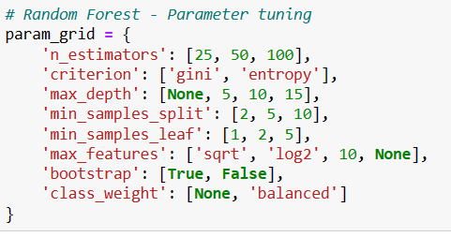
HYPERPARAMETER EXPLORATION Continue…
Logistic Regression
3. Artificial Neural Network (ANN)
Figure 17: Logistic Regression Hyperparameters
Figure 19: ANN Hyperparameters
2. Support Vector Machine (SVM)
4. Random Forest
Figure 18: SVM Hyperparameters
Figure 20: Random Forest Hyperparameters

Slide 18
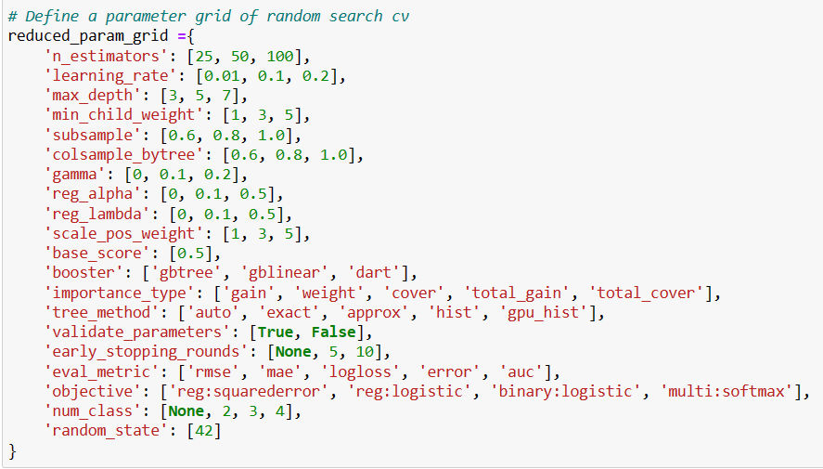
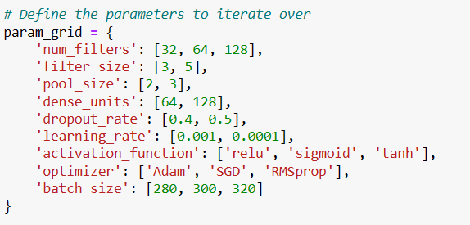
HYPERPARAMETER EXPLORATIONContinue…
5. XGBoost
6. Convolution Neural Network (CNN)
Figure 22: CNN Hyperparameters
Figure 21: XGBoost Hyperparameters

Slide 19
PART 01
3
R E S U L T

Slide 20
CONFUSION MATRIX
True Positives (TP):
This represents the number of instances that were actually positive (default) and was correctly predicted as positive by the model.
True Negatives (TN):
This represents the number of instances that were actually negative (non-default) and was correctly predicted as negative by the model.
False Positives (FP):
This represents the number of instances that were actually negative (non-default) but were incorrectly predicted as positive (default) by the model.
False Negative (FN):
This represents the number of instances that were actually positive (default) but were incorrectly predicted as negative (non-default) by the model.
Confusion Matrix | Logistic Regression | SVM | ANN | Random Forest | XGBoost | CNN
TP | 296 | 383 | 386 | 404 | 422 | 363
TN | 3973 | 3951 | 3944 | 3934 | 3927 | 3931
FP | 124 | 146 | 153 | 163 | 170 | 166
FN | 893 | 806 | 803 | 785 | 767 | 826
Data: After Splitting into 80% Training and 20% testing.
Training Data: 21142
Testing Data: 5286
Figure 23: Confusion Matrix Table

Slide 21
CLASSIFICATION REPORT
1) Precision: It represents the ability of the model to correctly predict positive instances (class 1) out of all instances it predicted as positive. For Example, a precision of 0.82 for class 0 and 0.70 for class 1 indicates that the model has higher precision for class 0 predictions compared to class 1 predictions.
2) Recall: It represents the ability of the model to correctly identify positive instances (class 1) out of all actual positive instances. For Example, a recall of 0.97 for class 0 and 0.25 for class 1 indicates that the model performs well in identifying class 0 instances but has a lower recall for class 1 instances.
3) F1-score: It is the harmonic mean of precision and recall, providing a balanced measure of the model's performance. For Example, the f1-score of 0.89 for class 0 and 0.37 for class 1 indicates that the model has better overall performance in predicting class 0 instances compared to class 1 instances.

Slide 22
CLASSIFICATION REPORT Continue…
Algorithm Name | Class | Precision | Recall | F1-Score
Logistic Regression | 0 | 0.82 | 0.97 | 0.89
 | 1 | 0.70 | 0.25 | 0.37
SVM | 0 | 0.83 | 0.96 | 0.89
 | 1 | 0.72 | 0.32 | 0.45
ANN | 0 | 0.83 | 0.96 | 0.89
 | 1 | 0.72 | 0.32 | 0.45
Random Forest | 0 | 0.83 | 0.96 | 0.89
 | 1 | 0.71 | 0.34 | 0.46
XGBoost | 0 | 0.84 | 0.96 | 0.89
 | 1 | 0.71 | 0.35 | 0.47
CNN | 0 | 0.83 | 0.96 | 0.89
 | 1 | 0.69 | 0.31 | 0.42
Figure 24: Classification Report Table

Slide 23
ROC Curve
Algorithm Name | ROC Curve
Logistic Regression | 0.73
SVM | 0.71
ANN | 0.78
Random Forest | 0.79
XGBoost | 0.79
CNN | 0.78
Figure 25: ROC Curve Table

Slide 24
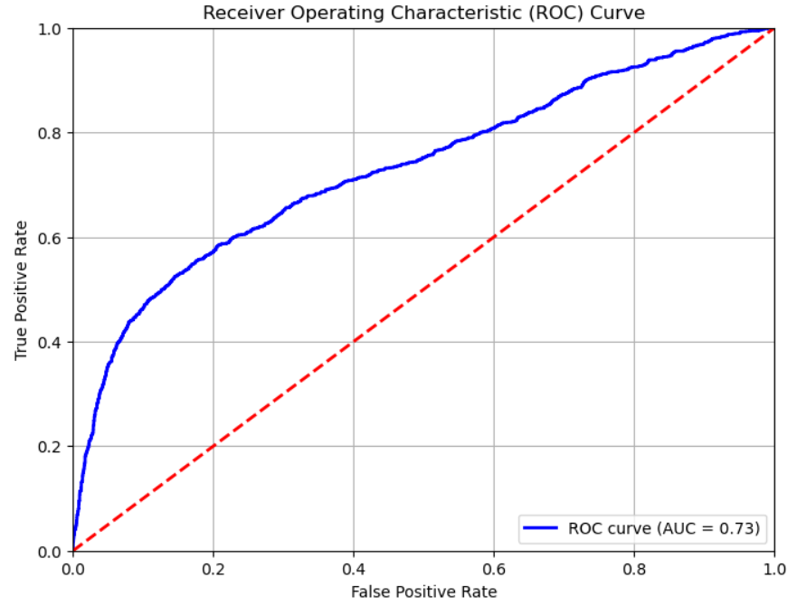
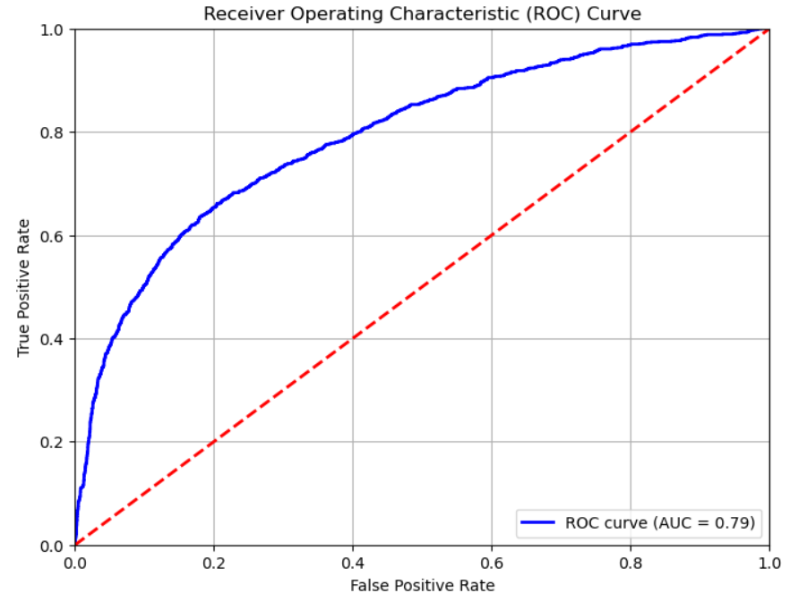
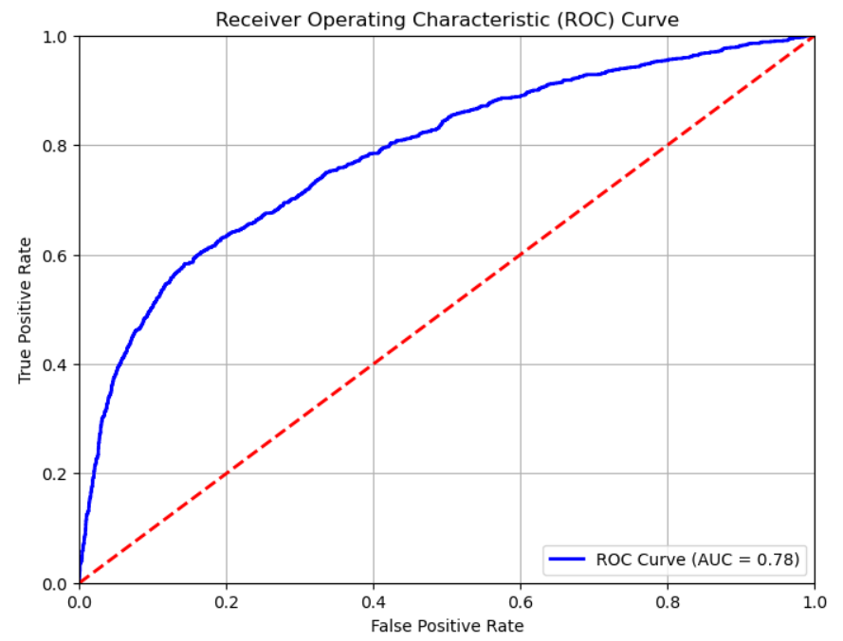
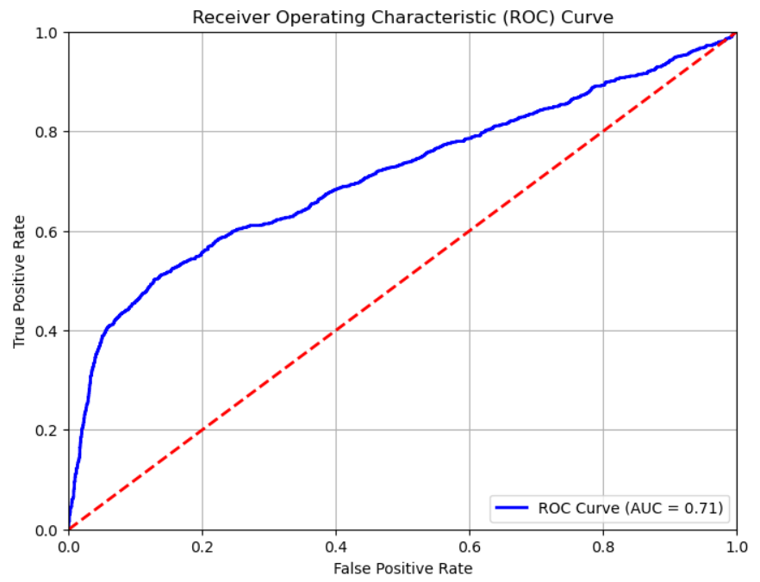
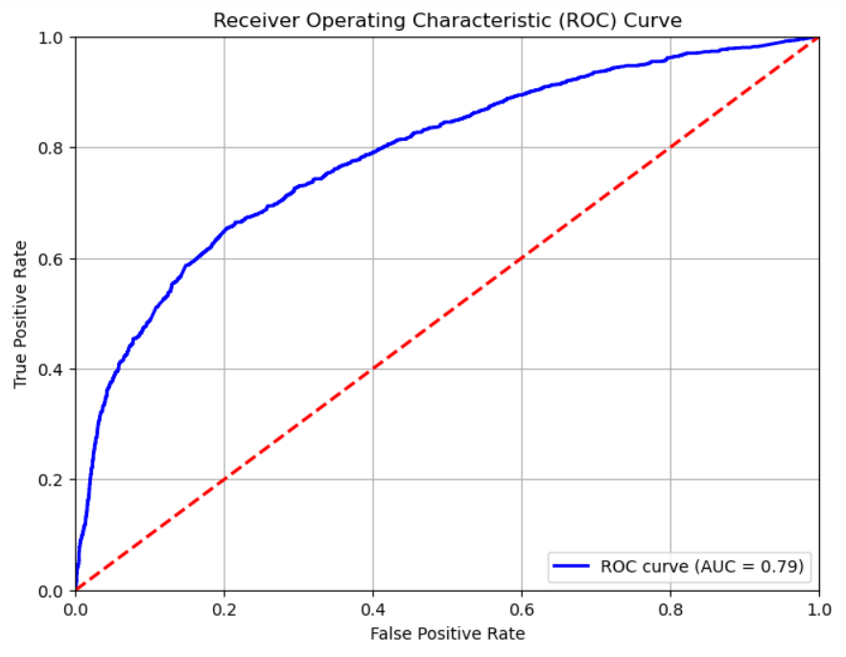
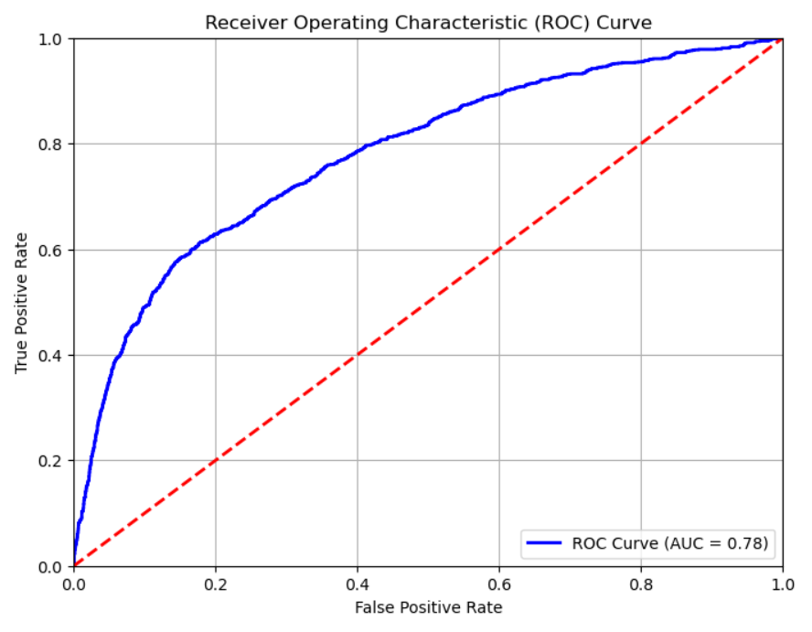
ROC Curve Continue…
1. Logistic Regression
5. XGBoost
3. ANN
Figure 26: Logistic Regression ROC Curve
Figure 30: XGBoost ROC Curve
Figure 28: ANN ROC Curve
2. SVM
4. Random Forest
6. CNN
Figure 27: SVM ROC Curve
Figure 29: Random Forest ROC Curve
Figure 31: CNN ROC Curve

Slide 25
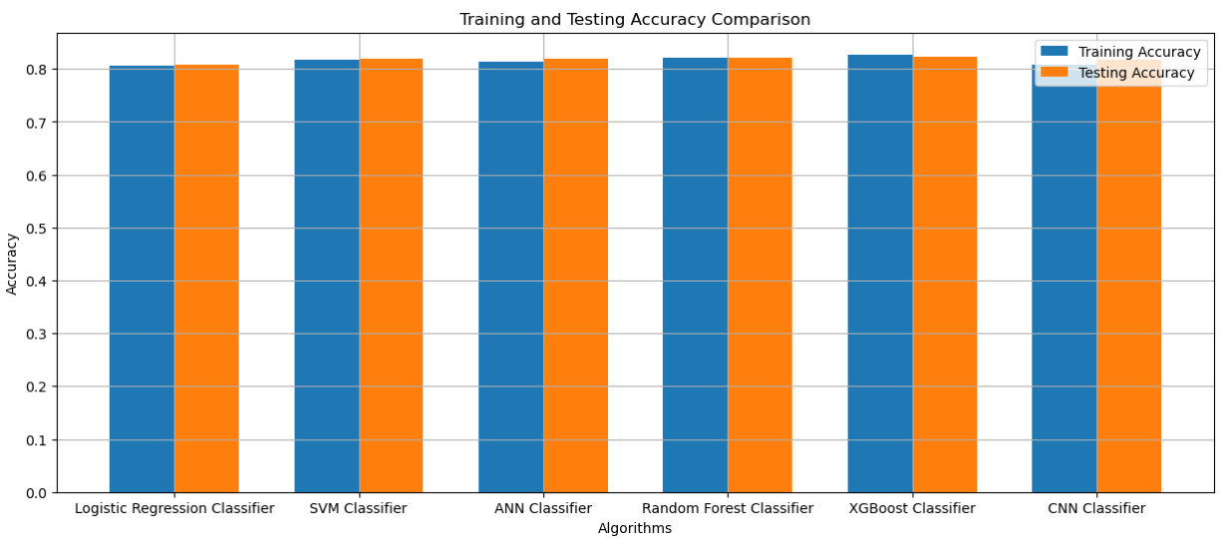
TRAINING & TESTING ACCURACY GRAPH OF 6 ALGORITHMS
The training and testing accuracy of different machine learning models were analyzed, including Logistic Regression, SVM, ANN, Random Forest, XGBoost, and CNN. The XGBoost Classifier showed the highest accuracy, closely followed by the Random Forest Classifier. The Logistic Regression, SVM, ANN, and CNN Classifiers exhibited similar performance with slightly lower testing accuracy values.
Figure 32: ALL 6 ALGORITHMS MODELS TRAINING AND TESTING ACCURACY COMPARISON

Slide 26
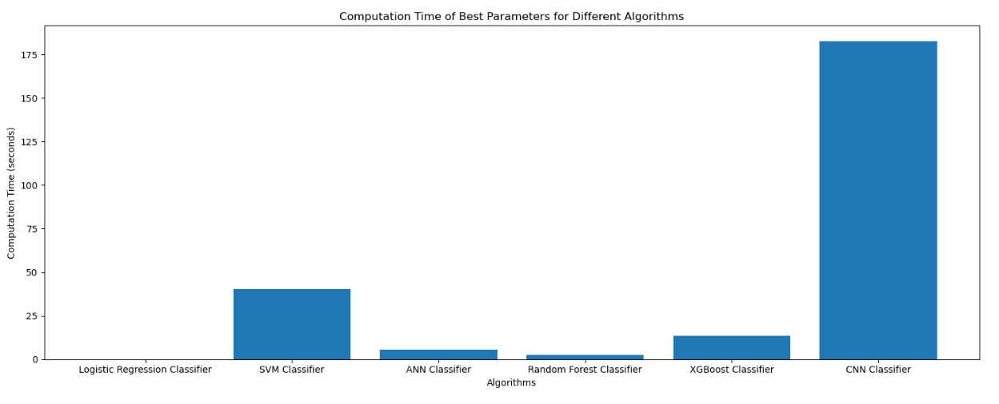
COMPUTATION TIME GRAPH OF 6 ALGORITHMS
1. Computation Times: Algorithms show significant variation in computation times, ranging from seconds to minutes.
2. Fast Algorithms: Logistic Regression and ANN Classifier have computation times of <1s and ~5.6s, respectively.
3. Moderate Algorithms: Random Forest and XGBoost Classifier take around 2.4s and 13.4s, respectively.
4. Time-Intensive Algorithm: CNN Classifier has the longest computation time of ~182.4s.
These insights highlight the trade-off between accuracy and computation time, with faster algorithms like Logistic Regression and ANN being suitable for quick results, while CNNs, despite their longer computation times, may offer higher accuracy.
Figure 33: ALL 6 ALGORITHMS MODELS Computation Time Comparison

Slide 27
COMPARISON OF ALL ALGORITHMS
From the above result for each of the algorithms, the performance of the algorithms can be evaluated as follows:
1. Logistic Regression:
- Training Accuracy: 0.8055
- Testing Accuracy: 0.8076
- F1-score (Class 1): 0.37
- Computation Time: 0.0781 seconds
2. SVM:
- Training Accuracy: 0.8181
- Testing Accuracy: 0.8199
- F1-score (Class 1): 0.45
- Computation Time: 40.5254 seconds
3. ANN:
- Training Accuracy: 0.8144
- Testing Accuracy: 0.8191
- F1-score (Class 1): 0.45
- Computation Time: 5.6107 seconds
4. Random Forest:
- Training Accuracy: 0.8206
- Testing Accuracy: 0.8206
- F1-score (Class 1): 0.46
- Computation Time: 2.3918 seconds
5. XGBoost:
- Training Accuracy: 0.8273
- Testing Accuracy: 0.8227
- F1-score (Class 1): 0.47
- Computation Time: 13.4150 seconds
6. CNN:
- Training Accuracy: 0.8073
- Testing Accuracy: 0.8169
- F1-score (Class 1): 0.42
- Computation Time: 182.4387 seconds
Considering from the above results, the XGBoost algorithm appears to be performing relatively well compared to the other algorithms. It has the highest training and testing accuracies, along with the highest F1 score for class 1. Additionally, it achieves a reasonable computation time of 13.4150 seconds, which is lower compared to the CNN algorithm.

Slide 28
PART 01
4
CONCLUSION & RECOMMENDATION

Slide 29
OBSERVATION & FINDINGS
EDA: Gain insights, visualize data distribution, examine class imbalance, explore categorical variables, and analyze feature relationships.
Data Pre-processing: Handle missing values, scale features, handle outliers, drop unnecessary columns, and split data for training and testing.
Hyperparameter Exploration: Explore parameter combinations using GridSearchCV and RandomSearchCV to find optimal values.
Model Performance: Different algorithms yield varying performance results across metrics like confusion matrix, accuracy, precision, recall, and ROC curve.
Overfitting and Underfitting: Address overfitting (high training performance, poor on unseen data) and underfitting (consistently low performance) using techniques like cross-validation.

Slide 30
POSSIBLE IMPROVEMENT DIRECTIONS
1
Feature Engineering: Enhance models' predictive power by exploring and creating new relevant features using domain knowledge and feature extraction techniques.
Ensemble Methods: Improve model performance by implementing ensemble methods like bagging or stacking, which combine multiple models to leverage their strengths and mitigate weaknesses.
Data Augmentation: Increase training data size and diversity through data augmentation techniques to enhance model generalization and performance, particularly when dealing with limited datasets.
Advanced Algorithms: Consider utilizing sophisticated algorithms and deep learning models such as LightGBM, AdaBoost, Neural Networks, or RNNs for complex tasks or when existing models struggle to capture intricate data patterns.
2
3
4

Slide 31
CONCLUSION
Implemented and evaluated machine-learning models for default credit card clients.
Emphasized the importance of thorough EDA, data pre-processing, and hyperparameter exploration for optimal model performance.
Compared the performance of different algorithms using task-specific metrics.
Identified directions for improvement: feature engineering, ensemble methods, data augmentation, and exploring advanced algorithms.
Aimed to enhance accuracy, robustness, and generalization capabilities through these enhancements.
Provided valuable insights into the performance of machine learning models.
Highlights areas for improvement and serves as a foundation for further enhancements and research in the field.

Slide 32
PART 01
5
R E F E R E N C E S

Slide 33
REFERENCES
[1.] Yeh, I. C., & Lien, C. H. (2009). The comparisons of data mining techniques for the predictive accuracy of probability of default of credit card clients. Expert Systems with Applications, 36(2), 2473-2480.
[2.] Yeh, I-Cheng, Wen-Hui Hsu, and Min-Hsin Chen. "A comparative study of data mining methods for credit card default prediction: a case study of Taiwan." Expert Systems with Applications 39.10 (2012): 9451-9460.
[3.] I-Cheng Yeh, Chih-Jen Lin, and Wen-Sheng Chu. "The comparison of data mining methods and Sorting Smoothing Method for the prediction of credit card clients' default." Expert Systems with Applications 39.3 (2012): 5750-5757.
[4.] Yeh, I-Cheng, et al. "A novel sorting smoothing method for the prediction of credit card clients' default." Expert Systems with Applications 41.10 (2014): 4389-4396.
[5.] Yeh, I-Cheng, et al. "The comparison of data mining methods and Sorting Smoothing Method for the prediction of credit card clients' default: A case study of Taiwan." Expert Systems with Applications 42.16 (2015): 5933-5941.
[6.] XGBoost Documentation: Chen, T., & Guestrin, C. (2016). XGBoost: A scalable tree boosting system. In Proceedings of the 22nd ACM SIGKDD International Conference on Knowledge Discovery and Data Mining (pp. 785-794).
[7.] Grid Search for Hyperparameter Tuning in Python (Article): Brownlee, J. (2021). Grid Search for Hyperparameter Tuning in Python. Machine Learning Mastery.
[8.] A Gentle Introduction to K-Fold Cross-Validation (Article): Brownlee, J. (2021). A Gentle Introduction to K-fold Cross-Validation. Machine Learning Mastery.
[9.] Deep Learning with Python by François Chollet (Book): Chollet, F. (2017). Deep Learning with Python. Manning Publications.
[10.] Keras Documentation: Chollet, F., et al. (2015). Keras: Deep Learning for Python.
[11.] Tensorflow Documentation: Abadi, M., et al. (2015). TensorFlow: Large-scale machine learning on heterogeneous systems.

Slide 34
THANK YOU

